Slide 1
Symmetric Encryption
Qilong Lin, Huidong Xu
19/12/2021

Slide 2

1
Introduction
2
Problem Description
3
Algorithms
4
Practical Algorithm
5
Conclusion

Slide 3

Introduction
01

Slide 4
Background
Nowadays, with the popularization of the Internet, more and more data is transmitted insecurely on theInternet, which just like a person running naked on the street. Encryption, which is defined as the processof encoding information in cryptography, can solve network transmission insecurity issues.

Slide 5




Application
Payment applications.
e.g. card transactions.
Validations to confirm that the sender of a message is who he claims to be.
Random number generation or hashing.
Encrypting data stored on a device when that data is not being transferred.

Slide 6
Pros and Cons
Pros
Compared to asymmetric cryption, symmetric cryption is faster to run because the keys used are much shorter than they are in asymmetric cryption. What's more, the fact that only one key gets used also makes the entire process faster.
Cons
However, symmetric also suffers from behavior where every use of a key \textit{leaks} some information that can potentially be used by an attacker to reconstruct the key, which may eventually causes the key to be cracked.

Slide 7
Problem Description
02

Slide 8
Definitions
Key (cryptography). A piece of information, usually a string of numbers or letters thatare stores in a file, which, when processed through a cryptographic algorithm, can encode or decodecryptographic data.
Symmetric-key algorithms. Algorithms for cryptography that use the same cryptographickeys for both the encryption of plaintext and the decryption of ciphertext.
Stream ciphers. A type of symmetric-key algorithms which encrypt the digits (typicallybytes), or letters (in substitution ciphers) of a message one at a time.
Block ciphers. A type of symmetric-key algorithms which take a number of bits andencrypt them as a single unit, padding the plaintext so that it is a multiple of the block size.

Slide 9
Definitions
Encryption. The process of encoding data to prevent it from intruders to read the originaldata easily. This stage has the ability to convert the original data (plaintext) into unreadable formatknown as ciphertext.
Decryption. The process to convert ciphertext into plaintext without missing any wordsin the original text.

Slide 10
Algorithms
03

Slide 11
Symmetric Algorithms
DES. An algorithm that takes a fixed-length string or plaintext bitsand transforms it through a series of complicated operations into another ciphertext bitstring of thesame length.
3DES. A symmetric-key block copher, which applies the DES cipher algorithm three times to each data block.The data Encryption Standard’s (DES) 56-bit key is no longer considered adequate in the face of moderncryptanalytic techniques and supercomputing power.
AES. An iterative instead of Feistel cipher. It is based on two common techniques to encrypt anddecrypt data knowned as substitution and permutation network (SPN).

Slide 12
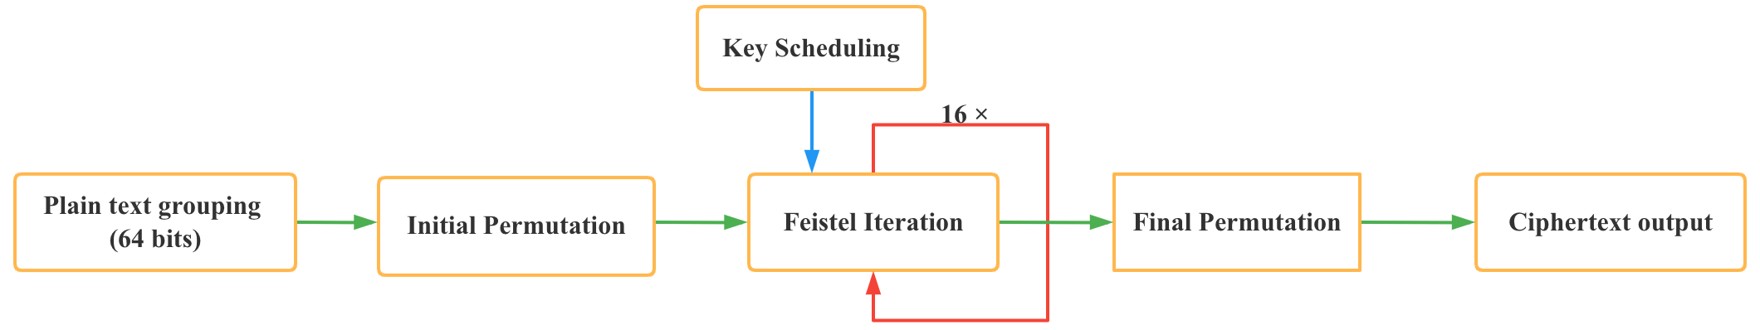
Data Encryption Standard (DES)
In the case of DES, the block size is 64 bits. DES also uses a key to customize thetransformation, so that decryption can supposedly only be performed by those who know the particularkey used to encrypt. The key ostensibly consists of 64 bits, however, only 56 of these are actually used by2
the algorithm. 8 bits are used solely for checking parity, and are thereafter discarded. Hence the effectivekey length is 56 bits. Decryptionuses the same structure as encryption, but with the keys used in reverseorder.

Slide 13
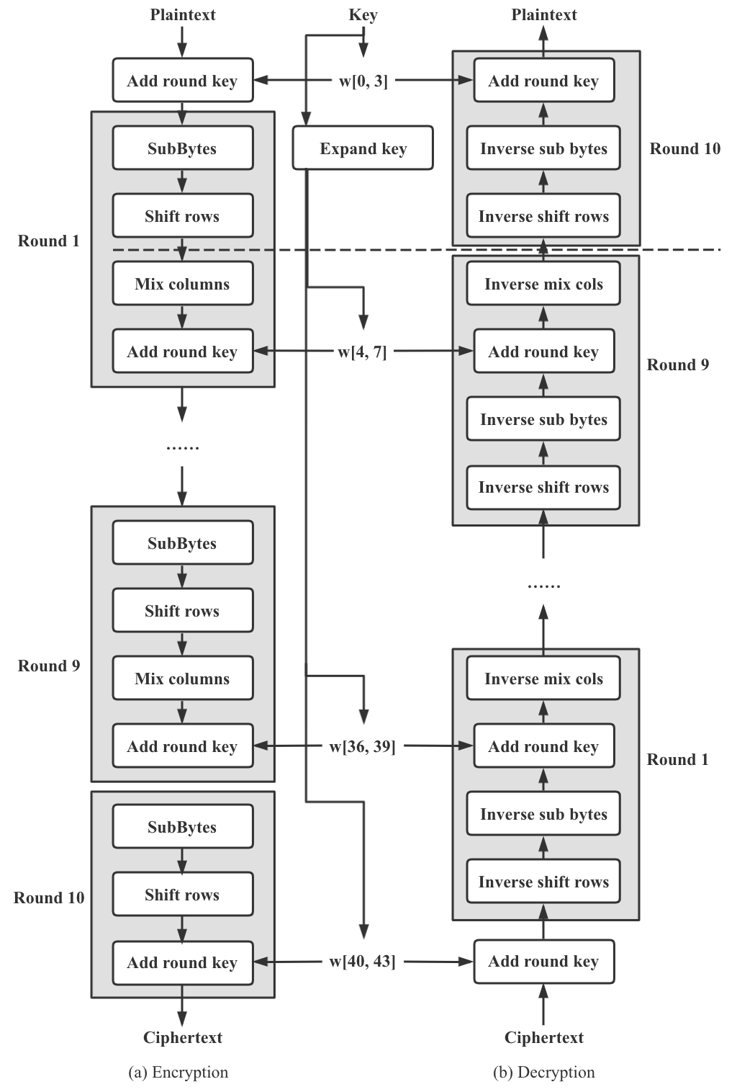
Advanced Encryption Standard (AES)
1. The Substitute Bytes Step.
2. The ShiftRows Step.
3. The MixColumns Step.
4. The AddRoundKey Step.
5. Optimization of the Cipher.

Slide 14
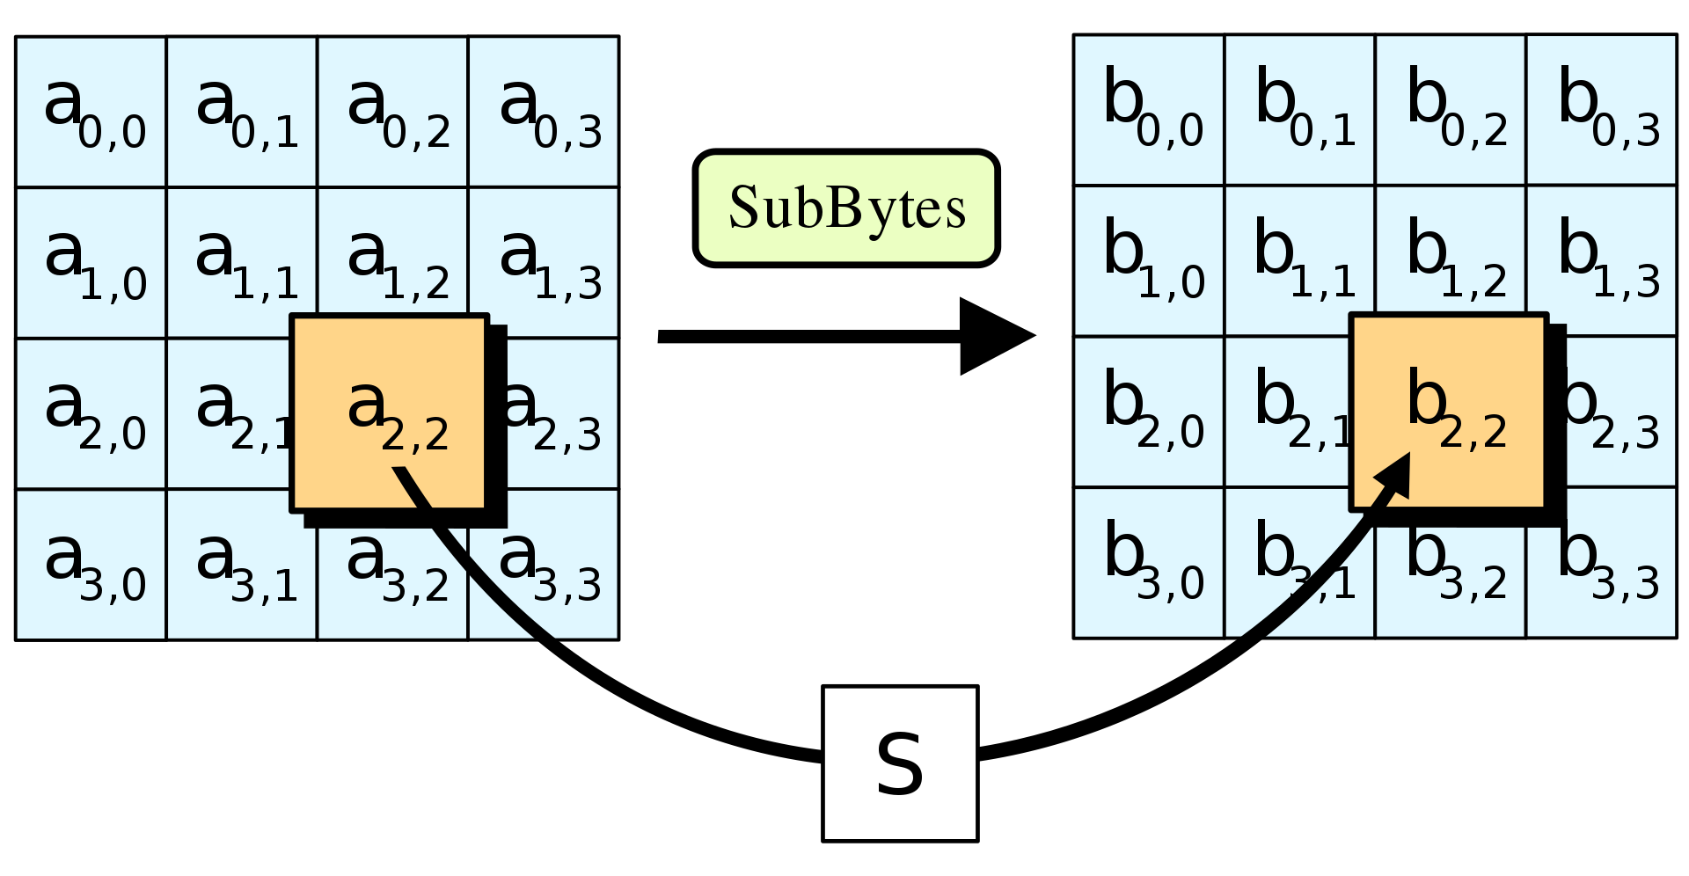
The Substitute Bytes Step
In the SubBytes step, each byte in the state array is replaced with a SubBytes using an 8-bit substitution box.

Slide 15
The ShiftRows Step
The ShiftRows step operates on the rows of the state; it cyclically shifts the bytes in each row by a certainoffset. For AES, the first row is left unchanged. Each byte of the second row is shifted one to the left.Similarly, the third and fourth rows are shifted by offsets of two and three respectively. In this way, eachcolumn of the output state of the ShiftRows step is composed of bytes from each column of the inputstate. The importance of this step is to avoid the columns being encrypted independently, in which caseAES would degenerate into four independent block ciphers.

Slide 16
The MixColumns Step
In the MixColumns step, the four bytes of each column of the state are combined using an invertiblelinear transformation. The MixColumns function takes four bytes as input and outputs four bytes, whereeach input byte affect all four output bytes. Together with ShiftRows, Mix Columns provides diffusionin the cipher.

Slide 17
The AddRoundKey Step
In the AddRoundKey step, the subkey is combined with the state. For each round, a subkey is derivedfrom the main key using Rijndael’s key schedule; each subkey is the same size as the state. The subkey isadded by combining each byte of the state with the corresponding byte of the subkey using bitwise XOR.

Slide 18
Optimization of the Cipher
On systems with 32-bit or larger words, it is possible to speed up execution of this cipher by combiningthe SubBytes and ShiftRows steps with the MixColumns step by transforming them into a sequence oftable lookups. This requires four 256-entry 32-it tables (together occupying 4096 bytes). A round canthen be performed with 16 table lookup operations and 12 32-bit exclusive-or operations, followed by four32-bit exclusive-or operations in the AddRoundKey step. Alternatively, the table lookup operation canbe performed with a single 256-entry 320bit table (occupying 1024 bytes) followed by circular rotationoperations.

Slide 19
Practical Algorithm
04

Slide 20
Practical Algorithm
· Symmetric encryption algorithms are used in many different fields in industry.
· The following mainly describes the application of symmetric encryption algorithm in the process of image encryption.

Slide 21
Performance considerations
For a gray scale image encryption algorithm, there are mainly these considerations in the industry:
1. The horizontal and vertical correlation of the encrypted images
2. The entropy of the encrypted images

Slide 22
Performance considerations
For a gray scale image encryption algorithm, there are mainly these considerations in the industry:
3. The Peak signal-to-noise ratio (PSNR) of the encryption
4. the throughput of the hardware implementation and the hardware resources required to achieve this throughput

Slide 23

Formal Definition
Horizonal / Second index
Vertical / First index

Slide 24
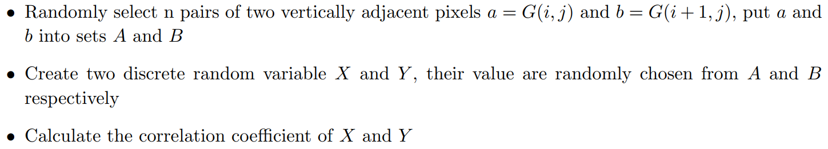
Formal Definition
The correlation coefficient we get is the vertical correlation defined above

Slide 25
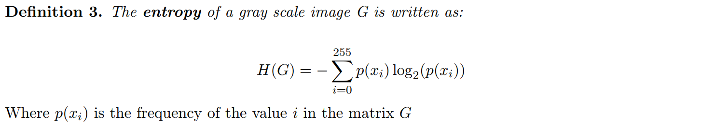
Formal Definition
The maximum entropy of a gray scale image is around 8

Slide 26
Formal Definition
About the above 2 definition:
· Correspond to the degree of visual confusion in the image
· Can be used as an indicator of the difficulty of cracking

Slide 27
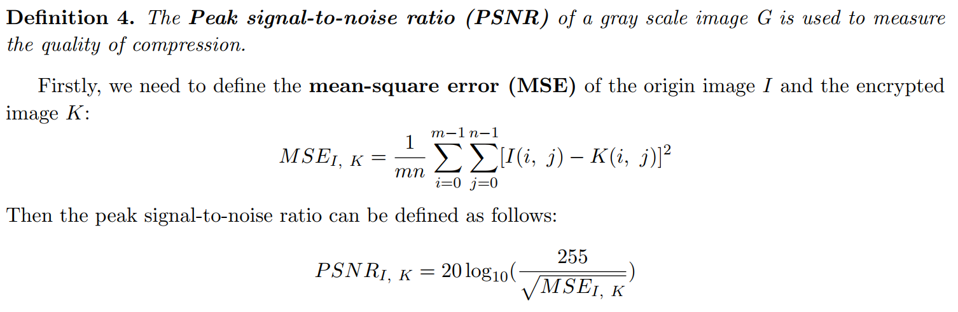
Formal Definition

Slide 28
Formal Definition
About the PSNR:
· Most commonly used to measure the quality of reconstruction of lossy compression codecs.
· The lower the PSNR, the more difficult it is to restore

Slide 29
Use AES Directly
Normally, AES can be used directly to encrypt gray scale images
· The frequency histogram of the encrypted image is quite different from that of the original image.
· The frequency of each gray value is basically the same

Slide 30
Use AES Directly
Normally, AES can be used directly to encrypt gray scale images
· The key space of AES encryption is very large
· The result of encryption will be very sensitive to the key

Slide 31
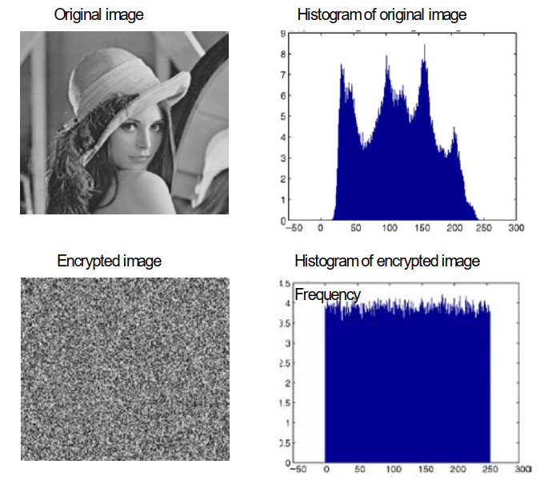
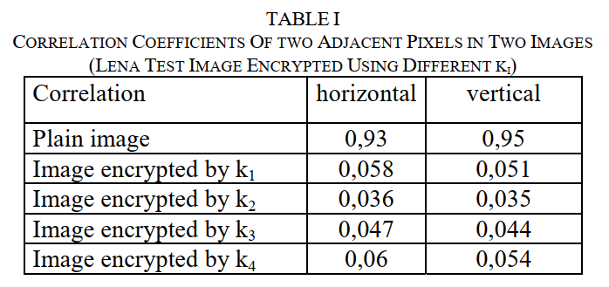
Use AES Directly
Normally, AES can be used directly to encrypt gray scale images

Slide 32
Problem
However, for some special cases, simply using the AES encryption algorithm can be problematic
· Consider using Electronic Codebook Book (ECB) mode for encryption, where the same data is encrypted to the same value
· May result in texture zone’s appearance

Slide 33
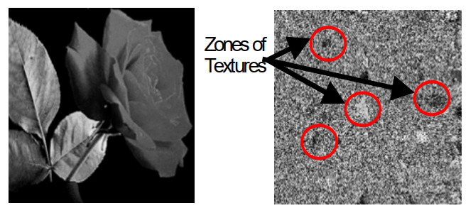
Problem
However, for some special cases, simply using the AES encryption algorithm can be problematic

Slide 34
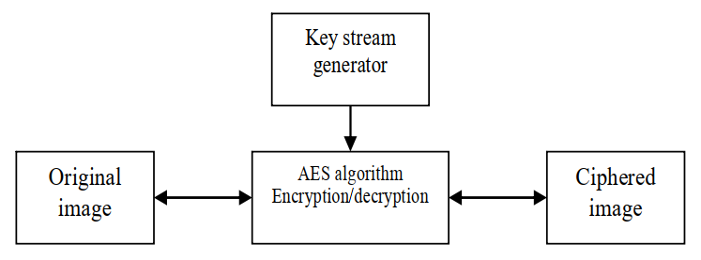
Improvement
To solve the problems mentioned above, we can combine the AES algorithm with stream ciphers
· Stream cipher is an algorithm that continuously generates keys based on the internal state of the key and algorithm.

Slide 35
Improvement
Why does it works?
· Originally, we used the key directly for each block of data
· With the introduction of stream ciphers, we can use a series of keys generated by stream ciphers to encrypt the block of data.

Slide 36
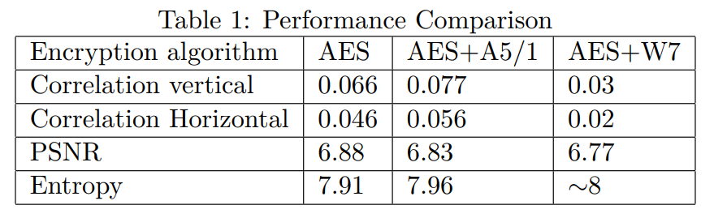
Improvement
Result of the improvement
Choose two kinds of stream ciphers A5/1 and W7 to combine with AES

Slide 37

Improvement
Result of the improvement
Disappearance of textures!

Slide 38
Conclusion
05

Slide 39
Future direction
Symmetric encryption algorithms have been used in many fields, what about the future?
· Considering how to better improve the hardware resources required by symmetric encryption algorithm may be an important direction
· Because in practical applications, besides the security of the algorithm, the speed of encryption and the hardware resources required by encryption are also important indicators

Slide 40
Future direction
Symmetric encryption algorithms have been used in many fields, what about the future?
· In today's popular cloud servers, encryption is essential because many steps in cloud servers rely on network transport
· How to design more efficient encryption algorithm in the cloud service scenario is also an important direction

Slide 41
Open problems
There are still many problems in the application of symmetric encryption algorithm
· In many cases, if we want to evaluate the quality of a symmetric encryption algorithm, we may need to implement it by hardware
· In other words, our evaluation of algorithm results is practice-dependent
· How to explain theoretically why an algorithm is better can be a difficult task

Slide 42
感谢聆听

